Slide 1





JavaScript Applications
Course Overview
Apps
JavaScript Applications
SoftUni Team
Technical Trainers
Software University
http://softuni.bg

Slide 2



Table of Contents
Course Objectives
Course Program
Trainers Team
Course Schedule
Exams and Evaluation
Learning Resources

Slide 3
Have a Question?
sli.do #js-apps

Slide 4

JS Core Module @ SoftUni
JavaScript Core
Intensive 4 Months JavaScript Training

Slide 5
JS Core Module Goals
4 months intensive JavaScript development training
5 times weekly, lots of live coding, homework and projects
Part I – JS Fundamentals
JS programming, functions, arrays, strings, objects, JSON, …
Part II – JS Advanced
jQuery, DOM, object composition, classes, modules, unit testing
Part III – JS Apps
REST, AJAX, promises, MVC, ReactJS, routing, building SPA

Slide 6
JS Core Module at SoftUni – Timeline
19-Sep-2016
17-Oct-2016
14-Nov-2016
11-Dec-2016
23-Dec-2016
JavaScript
Fundamentals
Lessons + exercises + team work project + exam
4 weeks * 5 times / week
9 credits
Start: 19-Sept-2016
Final exam: 16-Oct-2016
JavaScript Advanced
Lessons + exercises + exam
4 weeks * 5 times / week
9 credits
Start: 17-Oct-2016
Final exam: 13-Nov-2016
JavaScript Applications
Lessons + exercises + team work project + exam
4 weeks * 5 times / week
9 credits
Start: 14-Nov-2016
Final exam: 11-Dec-2016
Re-Take Exams
3 exams @ one week
16-Dec
19-Dec
22-Dec
Christmas Holidays
2 weeks holiday

Slide 7
Professions @ SoftUni
Jan 2017
May 2017
Sep 2017
Jan 2018
Java
Fund.
Java
DB
Web Basics
Java Web
Programming Basics
C#
DB
C#
Fund.
C#
Web
Web Basics
Tech Module
JS Core Module
Web
Basics
MEAN
Stack
PHP
Web
Web
Basics
https://softuni.bg/curriculum
https://softuni.bg/trainings/courses

Slide 8

JavaScript Applications
Apps
Course Objectives & Program

Slide 9

Course Objectives
The JavaScript Applications course provides
Technologies for creating Single Page Apps (SPA)
Consuming RESTful Services (REST) with AJAX
Creating UI components with ReactJS
Creating MVC-based SPA with AJAX, REST, mBaaS, ReactJS, routing, Sammy.js, promises

Slide 10
Course Topics
Course opening: topics, schedule, trainers, exams, resources
HTTP, REST Services, Postman
AJAX and jQuery AJAX
Asynchronous programming and promises
Creating single-page app with jQuery, AJAX, REST and Firebase
ReactJS: creating React components with JSX
MVC Architecture. Routing with Sammy.js
JS tools and libraries
Exam preparations + practical exam

Slide 11
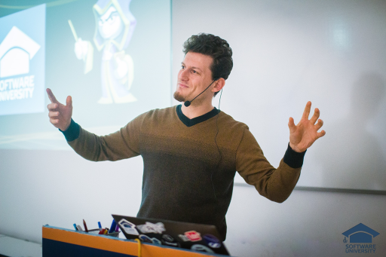
The Trainers Team

Slide 12
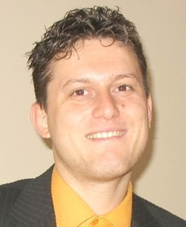
Trainers Team
Svetlin Nakov, PhD
Training & Inspiration Manager @ Software University (SoftUni)
20+ years software development experience
10+ years experience as trainer
Author of 7 programming books
Speaker at hundreds of events
Winner in International programming contests and Olympiads
Web site & blog: www.nakov.com

Slide 13
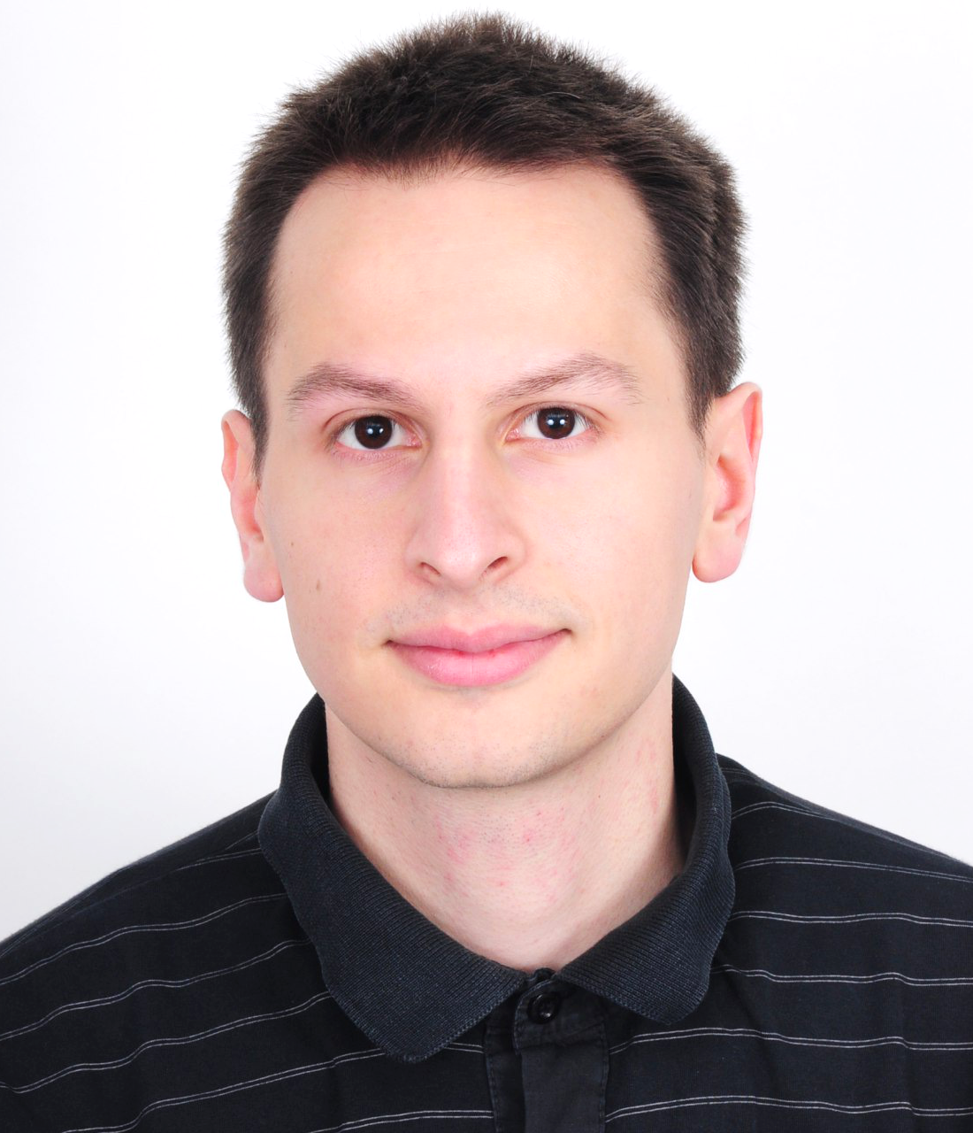
Trainers Team (2)
Viktor Kazakov
Technical Trainer @ Software University
Top performing student from the Software University
Interested in data structures and algorithms
Writes mostly in C#, but also knows C, C++, Java and JavaScript

Slide 14
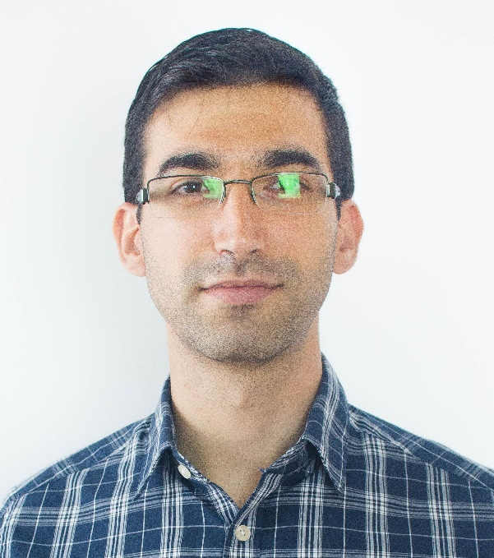
Trainers Team (3)
Viktor Kostadinov
Technical Trainer @ Software University
Programmed as a hobby since high school
Developed a resource-sharing website during his university years
Top performing student from the Software University
Interests include astronomy and game development

Slide 15
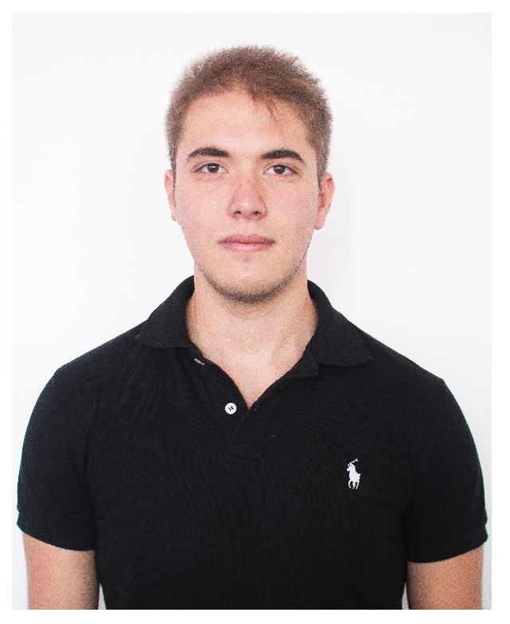
Trainers Team (4)
Ivaylo Zhelev
Technical Trainer @ Software University
Top performing student from the Software University
Interested in security and game development
Currently, writes mainly in JavaScript

Slide 16
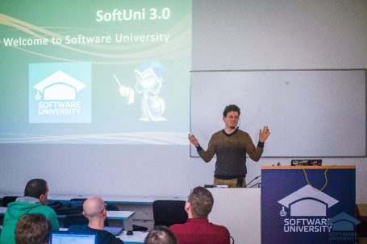


JavaScript Applications
Course Details and Schedule

Slide 17
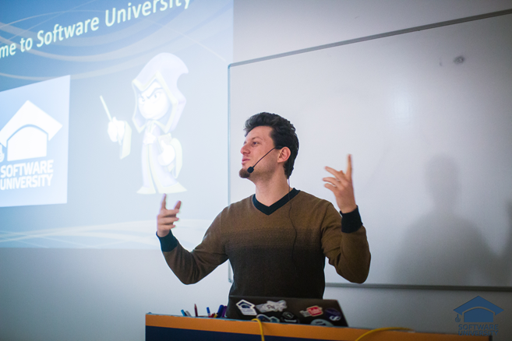
Training Duration and Schedule
Lessons: ~ 15-20 hours (onsite + YouTube videos)
Practical exercises (in class): ~ 30-40 hours
Homework: ~ 0-40 hours
Teamwork: ~ 20-40 hours
Teamwork defense: 0.5 hours
Time frame
Nov – Dec 2016

Slide 18


Why English?
Why the slides are in English?
English is the native language of the software engineers
Specific terminology should be in English
Translations are inaccurate and funny
Just learn English!
No excuses

Slide 19


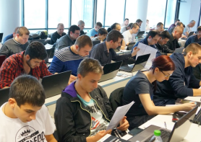
JavaScript Applications
Evaluation Criteria

Slide 20
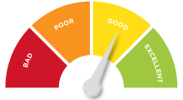

Scoring System for the Course
Mandatory:
Final exam – 70%
Homework submissions – 15%
Teamwork – 15%
Bonuses:
Presence in class – 5% bonus
Forum activity – bonus up to 5%

Slide 21

The Final Exam
Create a SPA (single page app)
Implement CRUD operations + login / register / logout
Use AJAX and REST + cloud-based back-end (Kinvey)
Optionally:
Use ReactJS for UI rendering
Use MVC architecture + routing (Sammy.js)
AJAX
REST
Kinvey

Slide 22


Homework Assignments
Your homework is mainly work in class!
Lesson days → slides + live demos + exercises
Exercise days → only exercises
How to submit your homework?
Some submitted in the judge system
Others uploaded in the course Web site
Homework assignments are due in 7 days

Slide 23

Teamwork Project
Build a team or work alone
Choose your teammates
Develop a practical project
Choose from existing projects
Or work on your own idea
Public defense
Demonstrate your work live at SoftUni

Slide 24










Resources
What We Need Additionally?

Slide 25



Course Web Site, Forum and FB Group
Official web site:
Official discussion forum:
Official Facebook group:
softuni.bg/courses/javascript-applications
softuni.bg/forum/categories/20
fb.com/groups/jscoresept2016

Slide 26

The Programming Basics Slides and Videos
All lecture slides, videos, homework assignments, projects and other resources are open content, available for free
Visit the course web site to access the course resources

Slide 27



Recommended Software
Software needed for this course:
Noje.js – https://nodejs.org
WebStorm – https://jetbrains.com/webstorm/
Optionally:
Visual Studio – https://www.visualstudio.com

Slide 28









JavaScript Applications – Course Overview
https://softuni.bg/courses/javascript-applications

Slide 29
License
This course (slides, examples, demos, videos, homework, etc.) is licensed under the "Creative Commons Attribution-NonCommercial-ShareAlike 4.0 International" license

Slide 30






Free Trainings @ Software University
Software University Foundation – softuni.org
Software University – High-Quality Education, Profession and Job for Software Developers
softuni.bg
Software University @ Facebook
facebook.com/SoftwareUniversity
Software University @ YouTube
youtube.com/SoftwareUniversity
Software University Forums – forum.softuni.bg

